Slide 1
Car MANUFACTURING APP
(Lightning Web Component)
CAPSTONE PROJECT
Vincent Michael M. Berdera

Slide 2
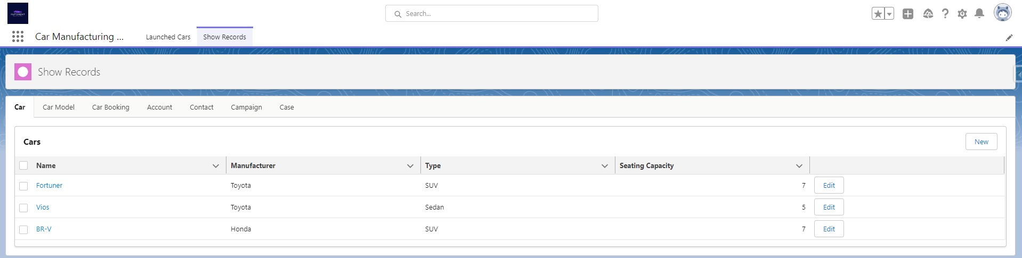
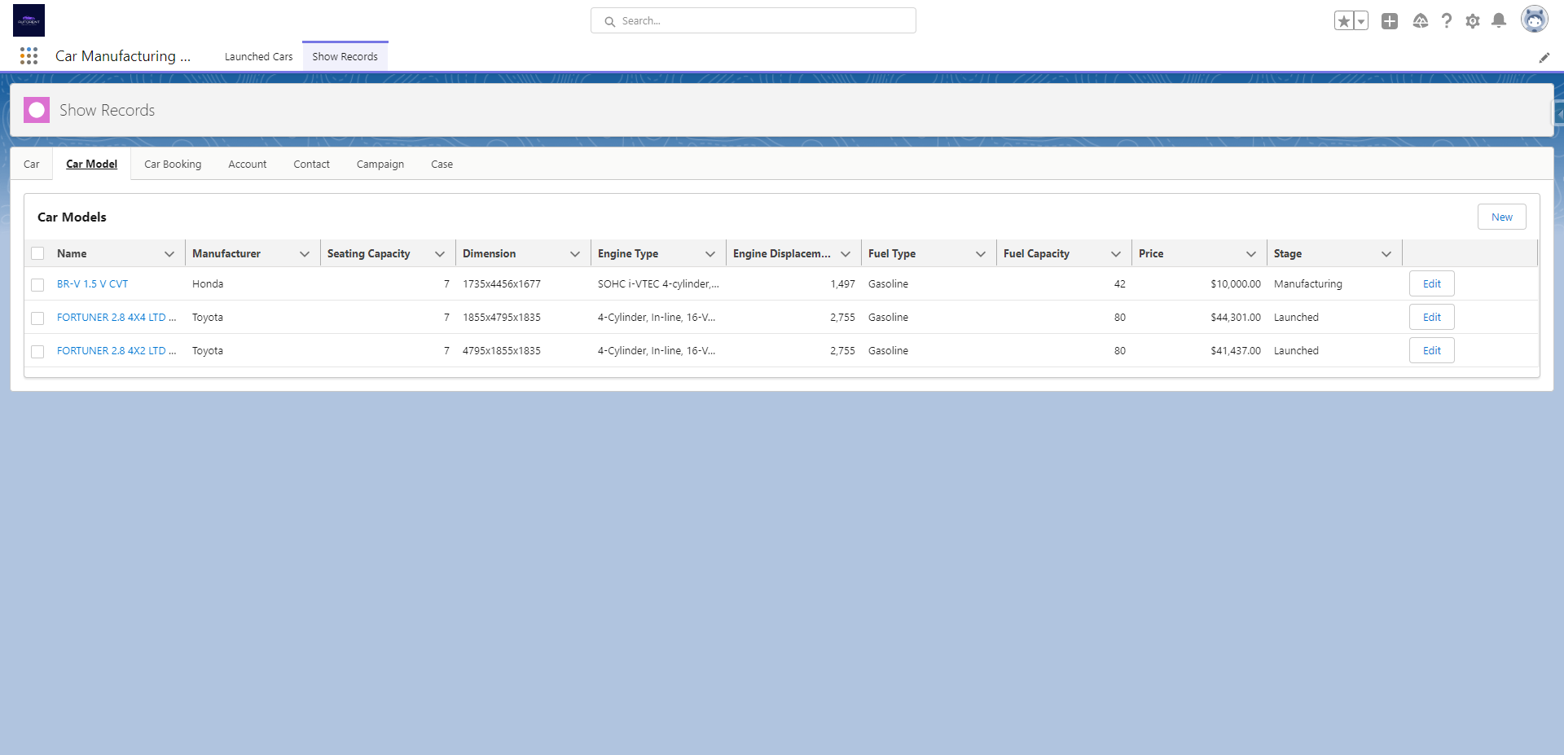
The Car and Car Model Object is accessible to all users.

Slide 3
Company executives has the highest access level for car related information.

Slide 4
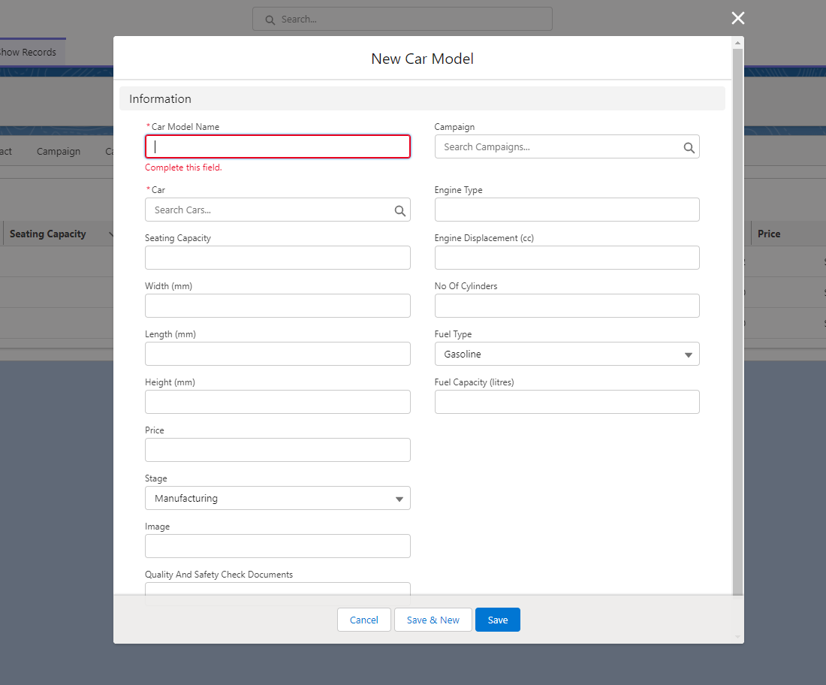
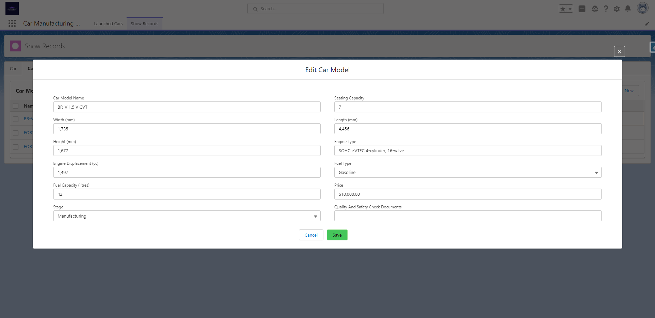
Factory Executives’ creation of car models requires a car to be related with and can only update data that is on “manufacturing stage” or “manufactured stage”.

Slide 5
If the user is the “Quality Analyst”, access on car models are only limited to car models that are in manufactured stage.

Slide 6

Quality analysts can only update the stage of the car model to “Ready for Launch“ and only after he put the URL of the Quality and Safety Check Documents

Slide 7

Digital Marketers has access to view all car model records except the records of those in manufacturing stage.

Slide 8
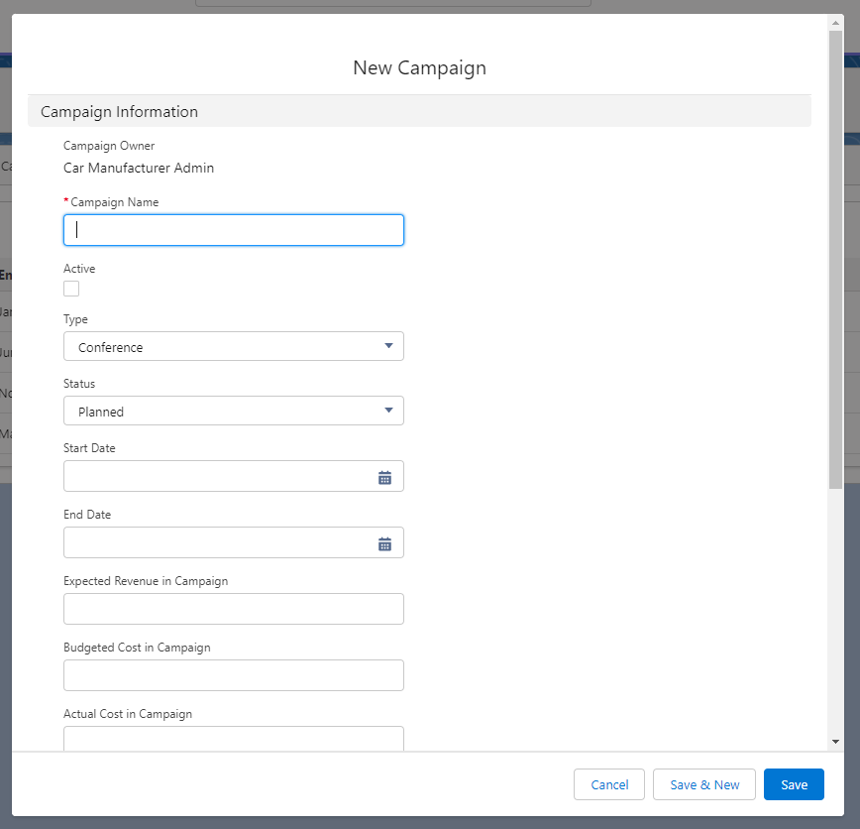
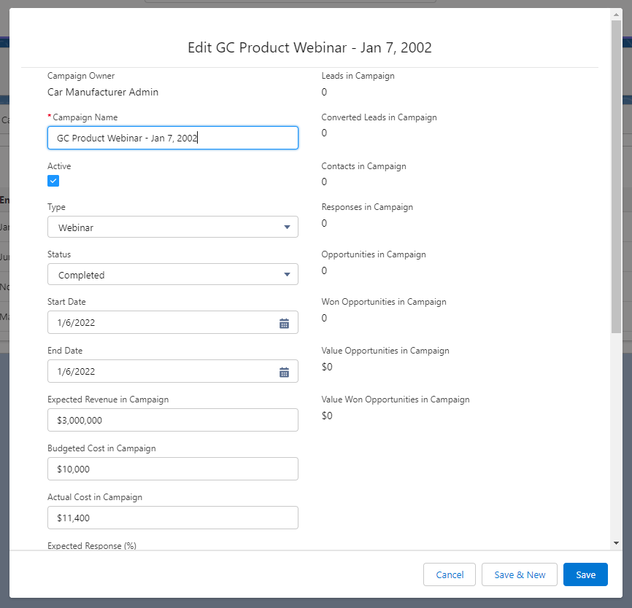
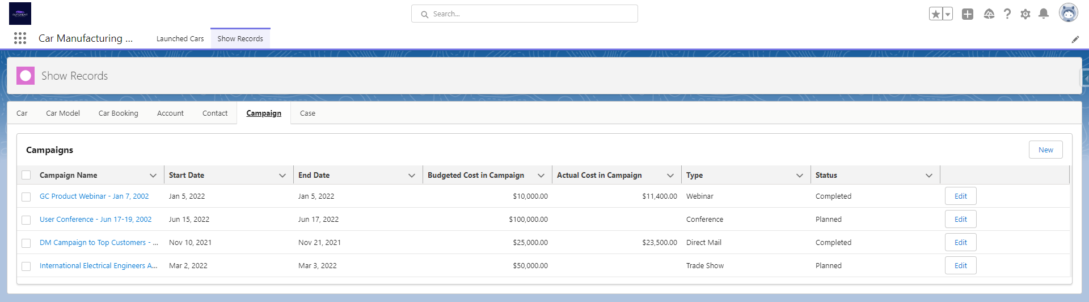
The Campaign tab is visible to customer support to view, but only Digital Marketers has the full access on this object. Digital Marketers can view, create, and edit a campaign.

Slide 9
Sales executives has access to view the records of car models that are in “Ready for Launch Stage” and “Launched Stage”, it also set to display in descending order depending on the day they are launched. Sales Executives also has the access to edit the stage from “Ready for Launch” to “Launched”.

Slide 10
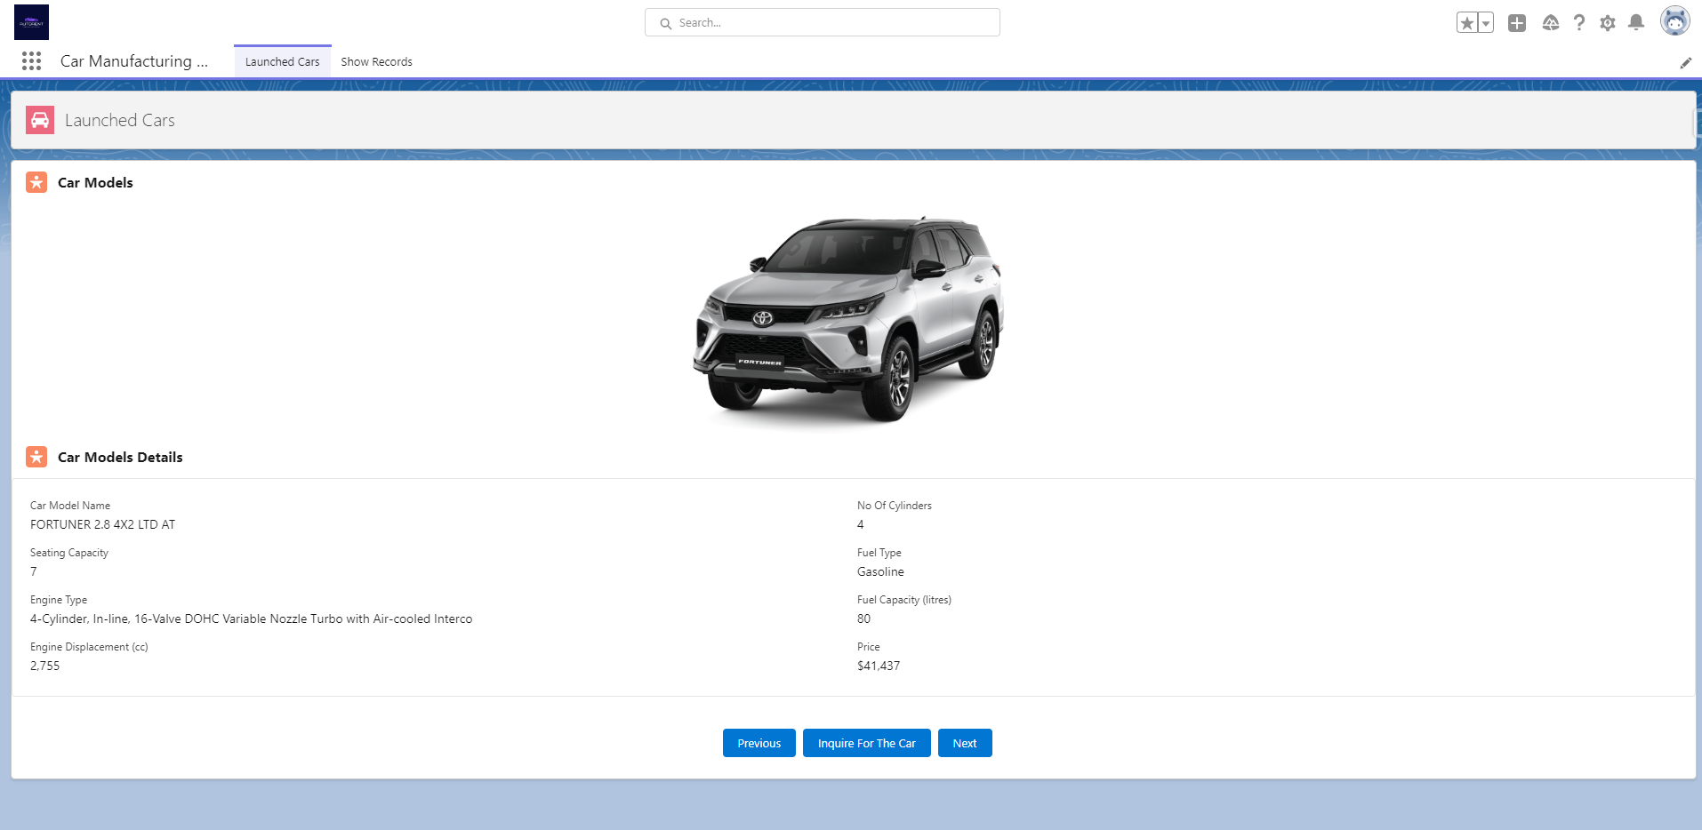
Special UI that is accessible to customers to browse on all the car models available in our App. It features the picture of the car model and also the relevant record of the model.

Slide 11
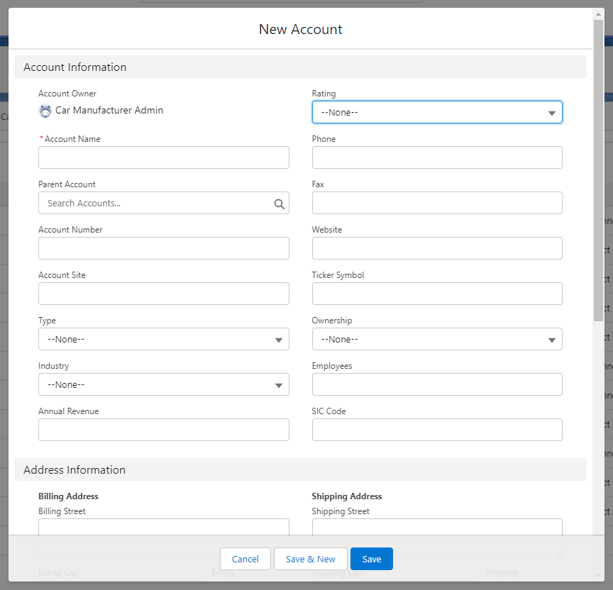
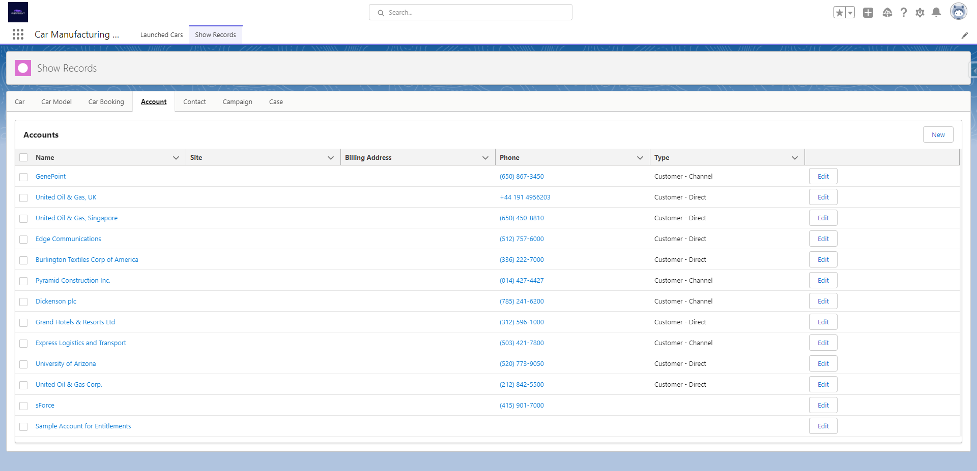
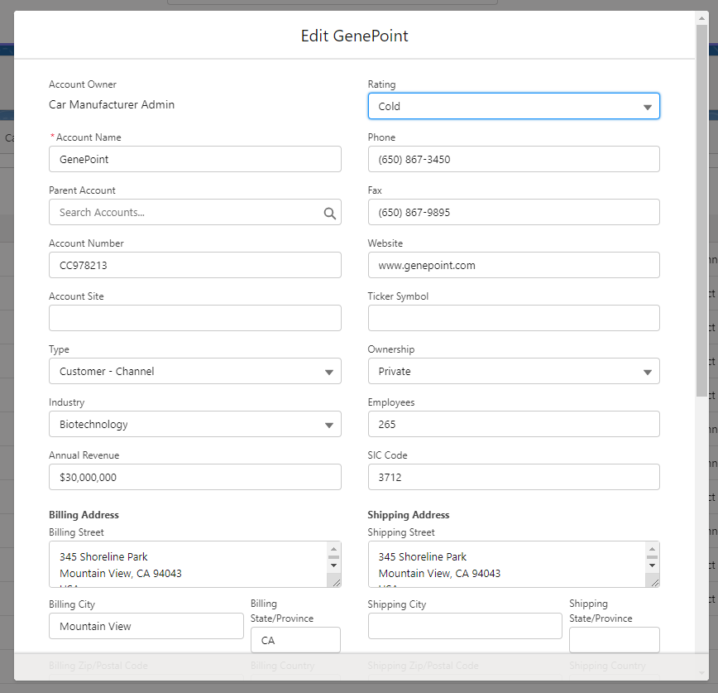
Sales Executives and Car Dealers can view, edit, and the only users who can create leads, accounts, and contacts for potential customers.

Slide 12
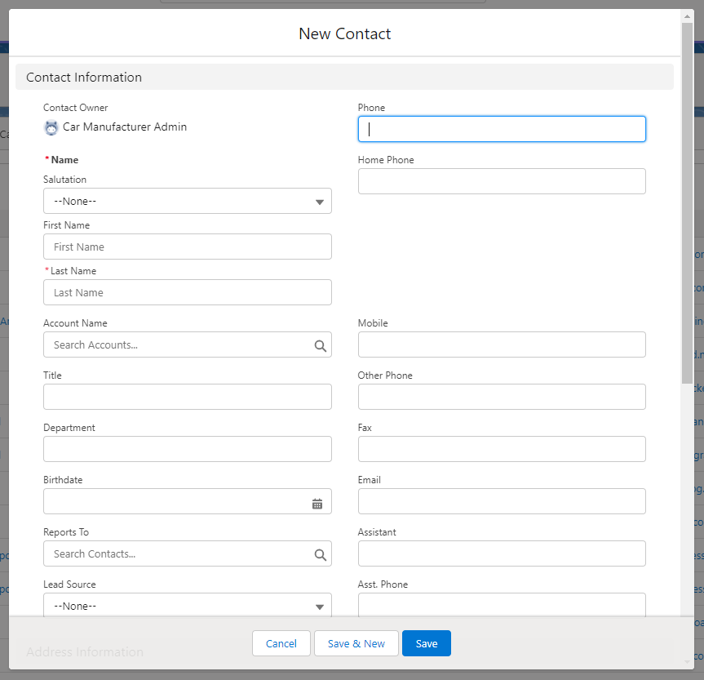
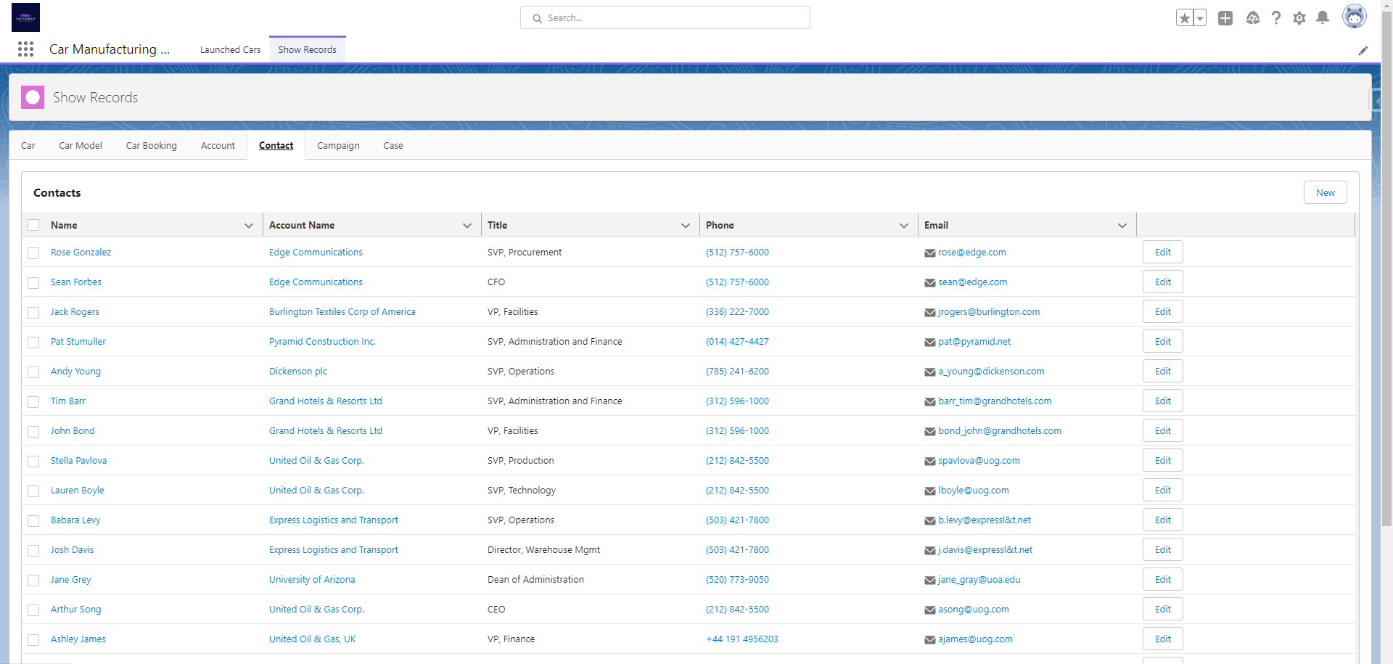
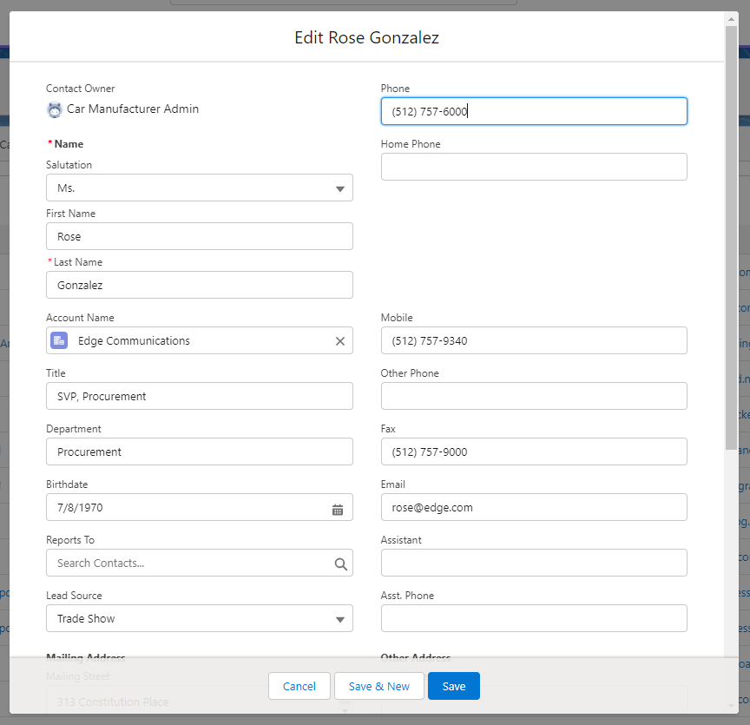
Sales Executives and Car Dealers can view, edit, and the only users who can create leads, accounts, and contacts for potential customers.

Slide 13

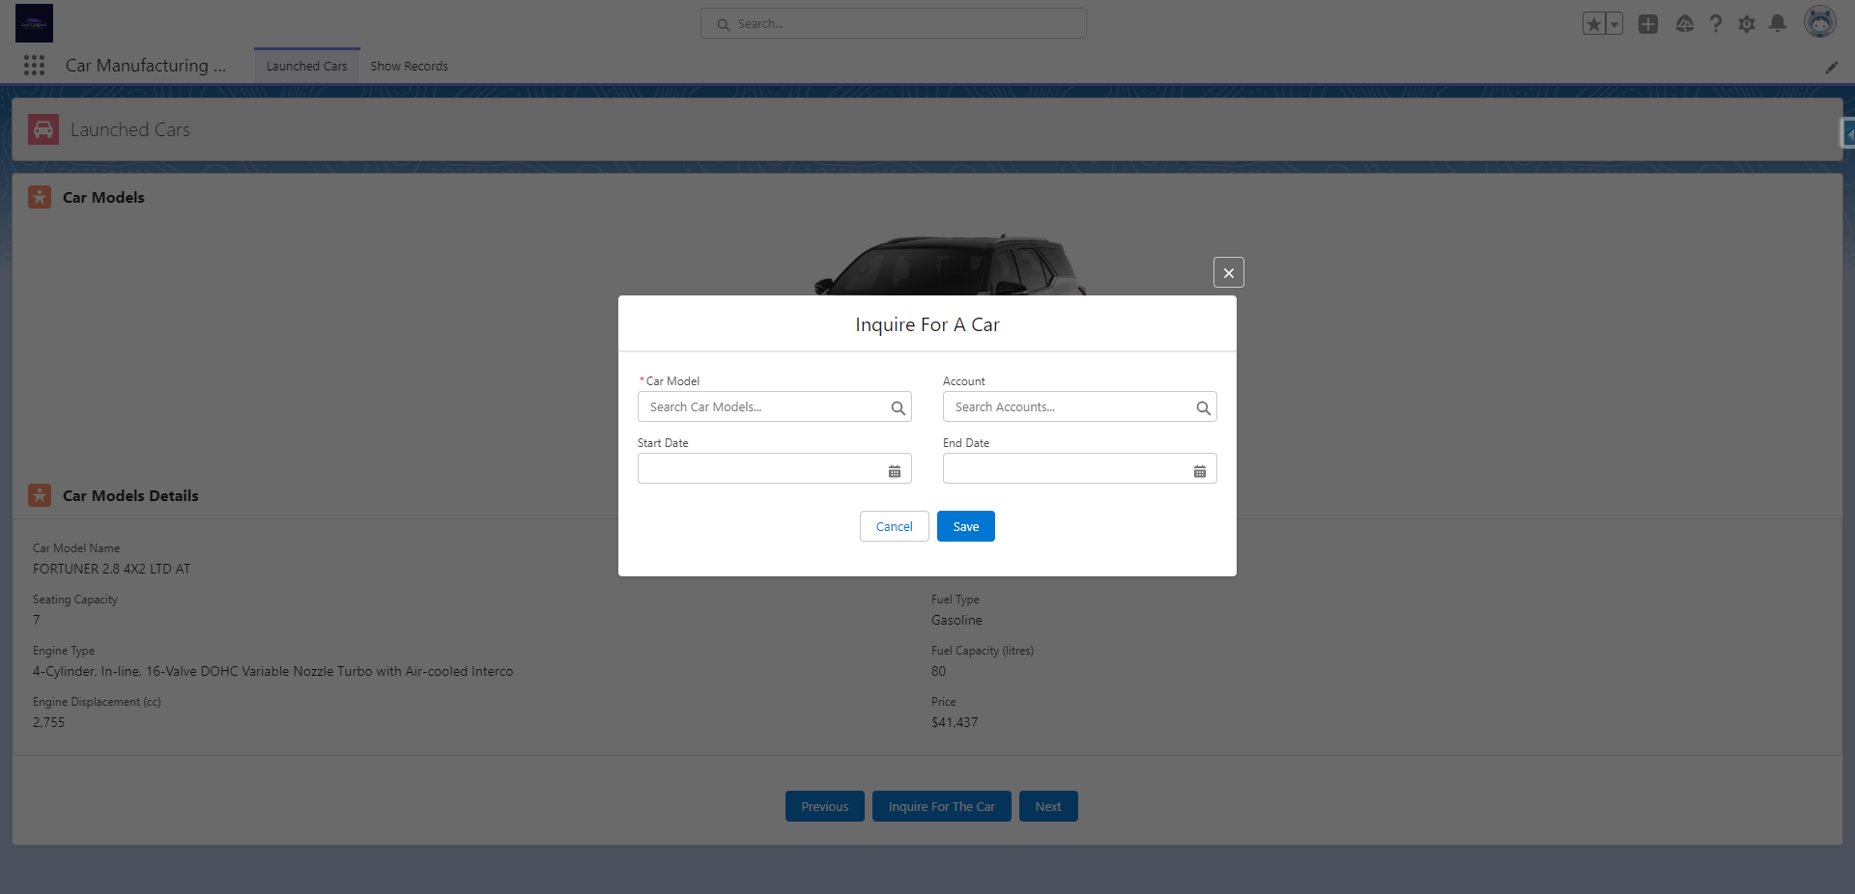
Special UI to customize the records for the car models that they want to book.

Slide 14

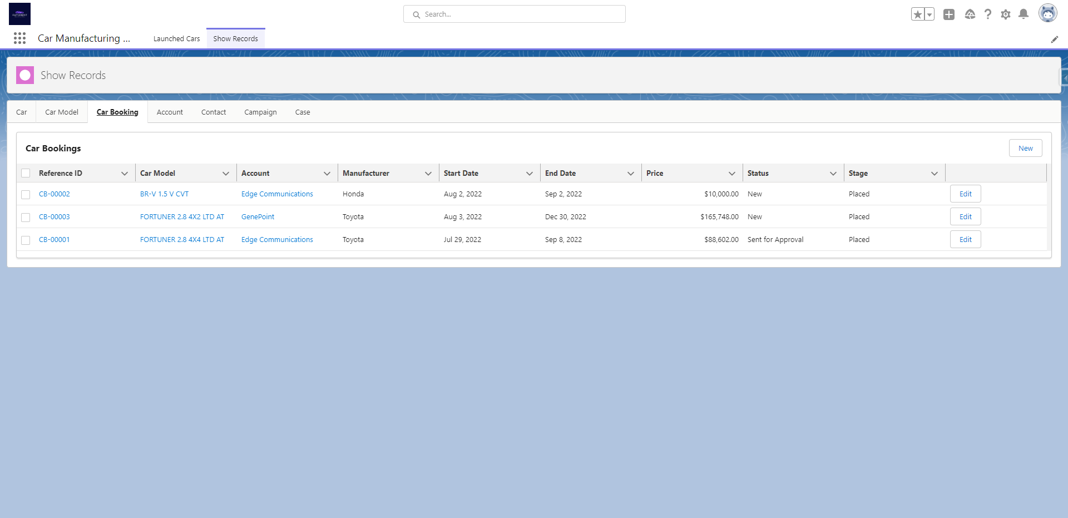
The car booking record for the customer will be automatically created, but not the designation of car dealers as sir Kumar instructed.

Slide 15

Once the car booking record is created it will be sent to approver and once the record is updated to paid it will be approved by the approver.

Slide 16

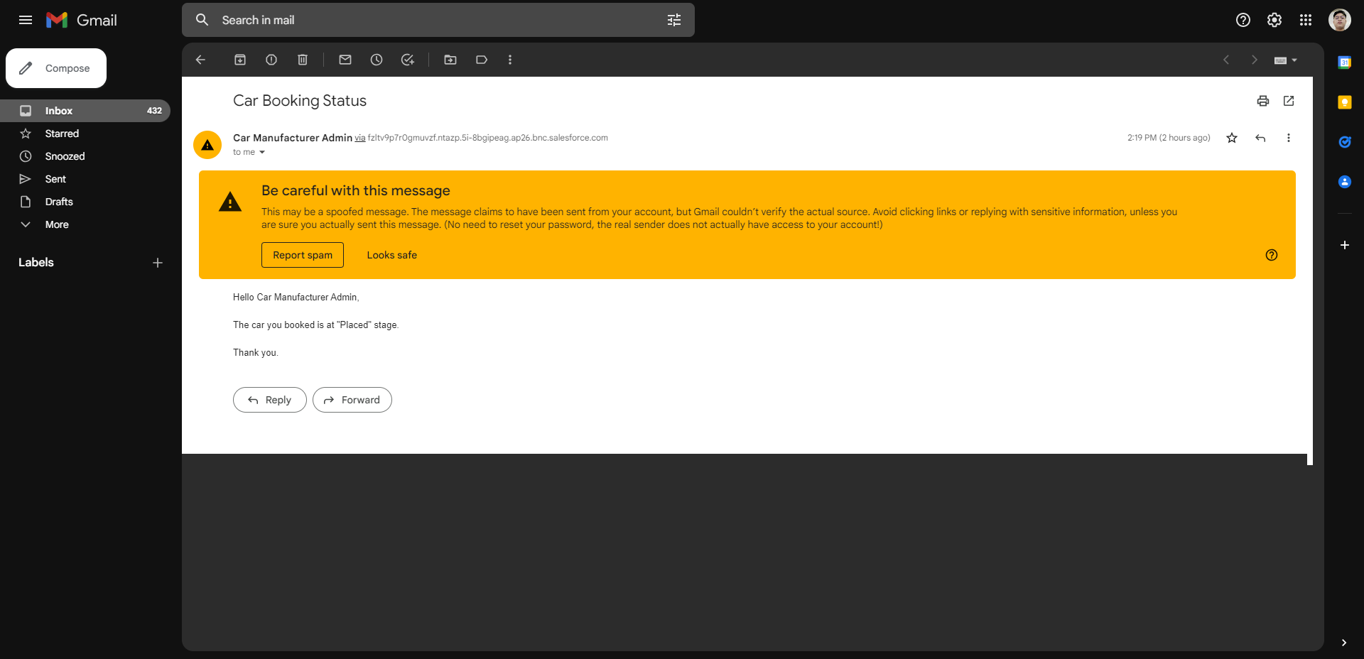
As per sir Kumar instructed we will send an email to customer for every update of delivery stage.

Slide 17
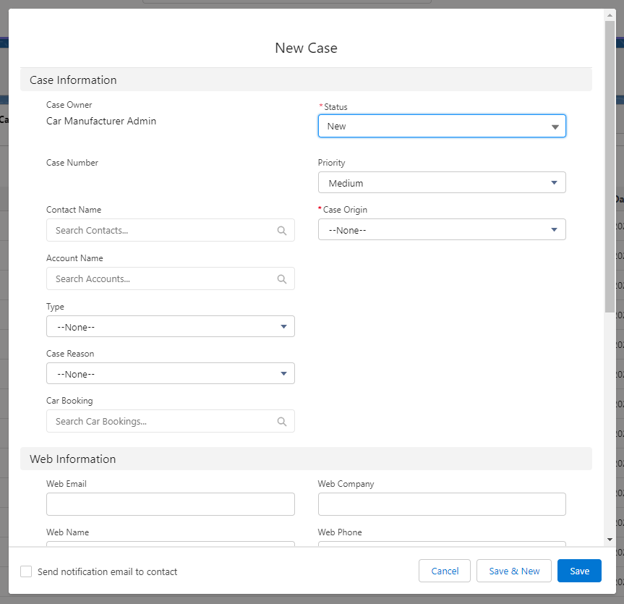
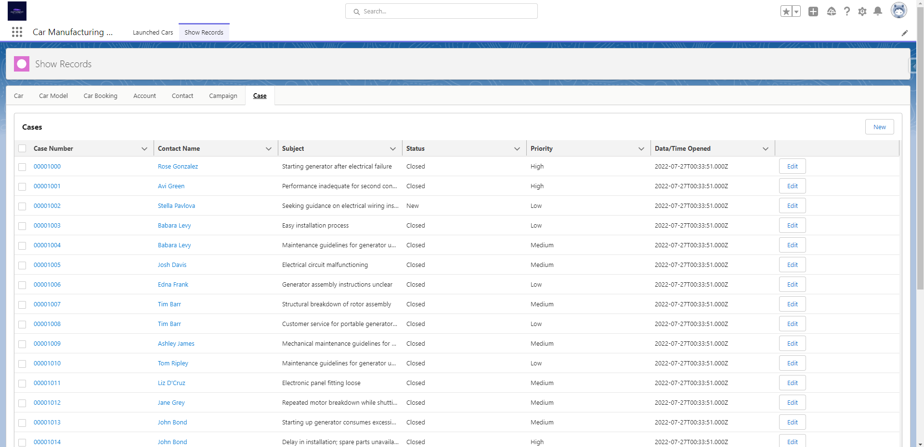
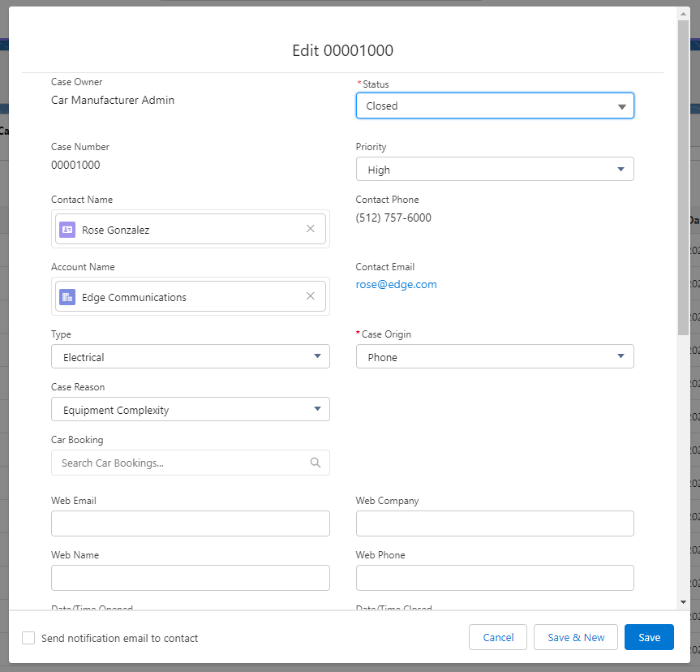
Cases are accessible to all users, but customer service representatives are the only users who are allowed to create cases.

